Slide 1
Fundamentals of System Hardware

Slide 2
Overview
Definition of a computer
Types of computers
What’s inside a computer (macro view)
What each component does
Commonalities between components
How components communicate
How the CPU works
The memory hierarchy
Hard disks
Networking

Slide 3
Definition
The computer is an electromechanical device which takes input, does processing and produces output.

Slide 4
Types of computers
Mainframe
Server
Desktop
Laptop
Tablet
Portable phone
Notes:
Laura, Can we use some stock images for these?

Slide 5
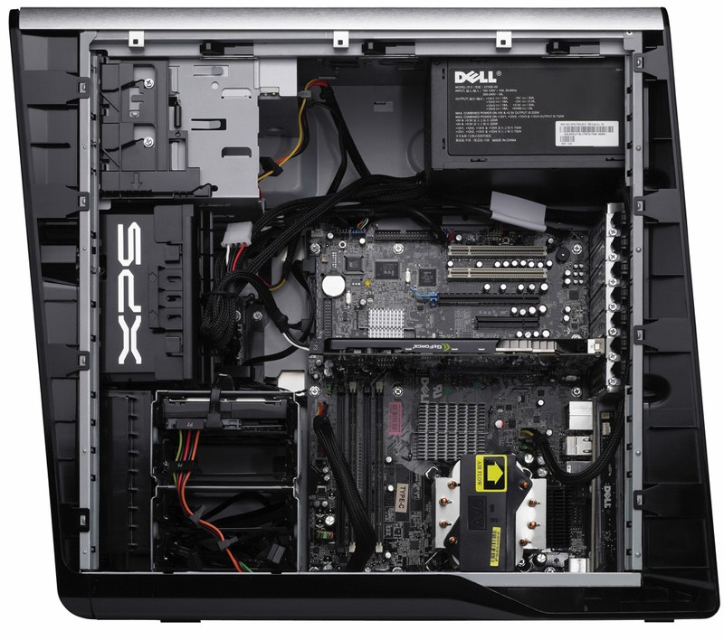
Inside a computer
Notes:
Source: http://www.blogcdn.com/www.engadget.com/media/2008/02/2-26-08-xps_630_inside.jpg

Slide 6
What’s common between them?
All computers have:
at least one Central Processing Unit (CPU) which is the “brain” of the computer.
Main memory where code and data is stored temporarily
Secondary storage where information is stored permanently
Most computers will have:
A video graphic controller where images can be rendered for display on a screen
A network interface for communications
Peripheral interfaces (USB, Thunderbolt, Firewire, SCSI, etc)

Slide 7
Communications between the devices
Internal communications in a machine is done via a “bus.”
A bus is a physical pathway for communication between two or more devices
The system bus is the main pathway between the CPU and main memory, but also carries data to and from Input and Output (IO) devices.

Slide 8
The CPU
The CPU is the “brain” of the computer
It is a single piece of silicon in the form of a chip.
This is the only location where code is actually executed in the system.
The CPU only runs “machine language” code.
The CPU operates on a “fetch-decode-execute” cycle.
Each type of CPU has its own set of “instructions” which is understands.
Each CPU has a small amount of memory, call “registers” which it uses to perform operations and store results.
A CPU ay have a “cache” memory to perform more quickly.

Slide 9
Machine-Language
Computers can only understand very basic commands like
Move
Add
Subtract
Multiply
Compare
Jump
etc
The designer of the CPU puts the capability to perform these operations in the physical chip.

Slide 10
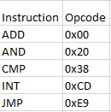
Instruction set
The designers of the CPU create a set of instructions that the CPU can perform.
This set of instructions, usually as small as 100, can each be represented by a numeric value.
When the CPU receives a particular instruction, it performs that task.

Slide 11
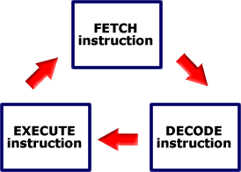
Fetch-Execute Cycle
The CPU performs a fetch to move the instruction from main memory into the CPU (specifically into an instruction register).
It then decodes the instruction, also moving in any additional data that might be necessary with that instruction
It then executes that instruction
This process repeats with the next instruction in the sequence
This whole process can take as little as about 0.00000001 seconds or about 10 nanoseconds. Meaning the CPU can process millions of instructions per second.
Notes:
Source: www.eastaughs.fsnet.co.uk/images/pictures/instructioncycle.gif

Slide 12
Memory
The Instruction, and all the data, has to come from somewhere.
In order for code to be executed, it has to be in a register built into the CPU
Why not just store everything in registers? They are EXPENSIVE!
As memory gets faster, it tends to get more expensive. So we have a hierarchy

Slide 13
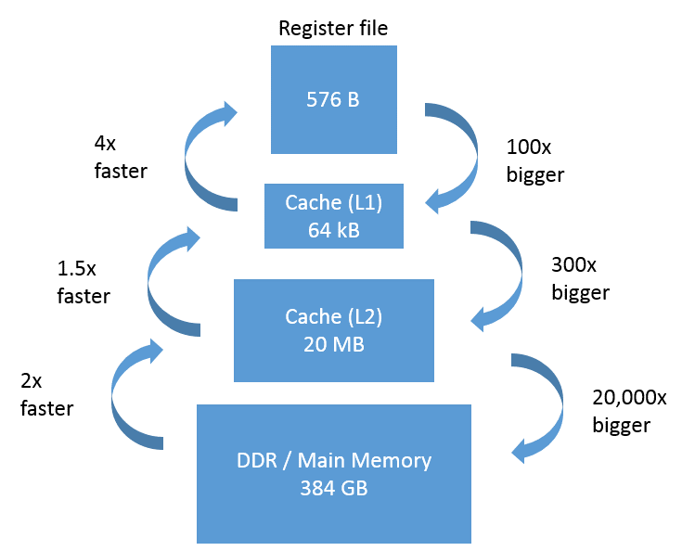
Notes:
Source; https://software.intel.com/sites/default/files/managed/5f/b0/KitchenMemoryFigureScale.png

Slide 14
The hierarchy
Registers (Nanosecond access time, but size measured in bytes)
Instructions can be executed only here
Cache (Nanosecond access time, size measured in megabytes)
Useful for the processor designers, not terribly useful for programmers
RAM (10+ nanosecond access time, size measured in gigabytes)
This is where all of your code and data will be stored temporarily
This is known as volatile memory because it is all lost when the computer is off
Secondary Storage(10 millisecond access time, size measured in terabytes)
Permanent storage, your hard drive.
Tierterary storage (offline, size measured only by your imagination)
Used for backup or other information that doesn’t need to be immediately accessible

Slide 15
RAM
Known as RANDOM Access Memory because any place in it can be accessed in the same amount of time (which is not necessarily true for older secondary storage).
This areas of memory is broken down into bytes, with each byte being able to be accessed independently of the others
When the computer is turned off, everything in RAM is lost.
When running a program, all the machine language instructions are brought into RAM and, one-by-one, pulled into the CPU by the fetch and execute cycle.

Slide 16
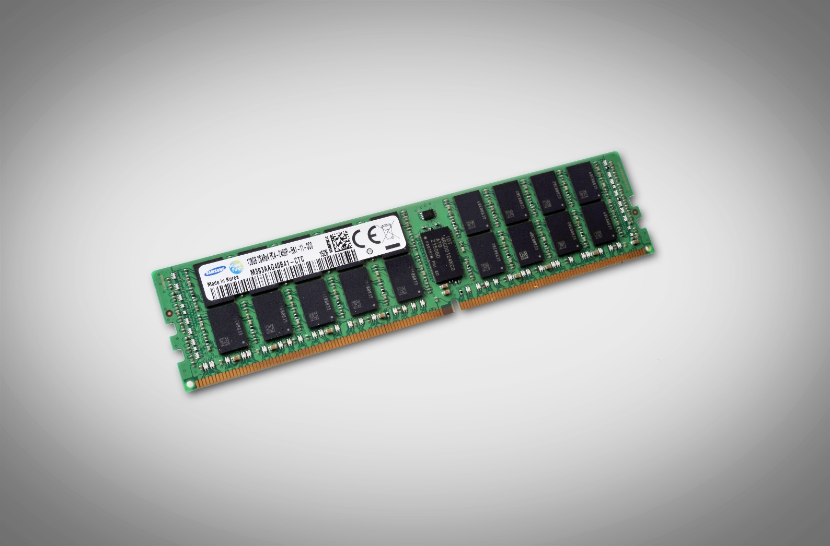
Notes:
Source: https://news.samsung.com/global/samsung-starts-mass-producing-industrys-first-128-gigabyte-ddr4-modules-for-enterprise-servers

Slide 17
Secondary Storage
Secondary storage can usually be broken down into two types
Hard disk drive (HDD) also known as “spinning” drives.
Contain multiple magnetic material discs which rotate together at a constant velocity
Contain read heads which move to different radii on the disk
Allow the system to access any position via it’s three dimensional polar coordinates
Accessing first the innermost radius then the outermost radius takes significantly longer than two adjacent radii.
Size is usually measured in terabytes
Solid State Disks
Contain a number of chips like USB flash drives.
Data is stored, electrically, in these chips
All data can be access in the same amount of time
Due to cost, these drives a smaller than HDDs but perform much faster.

Slide 18
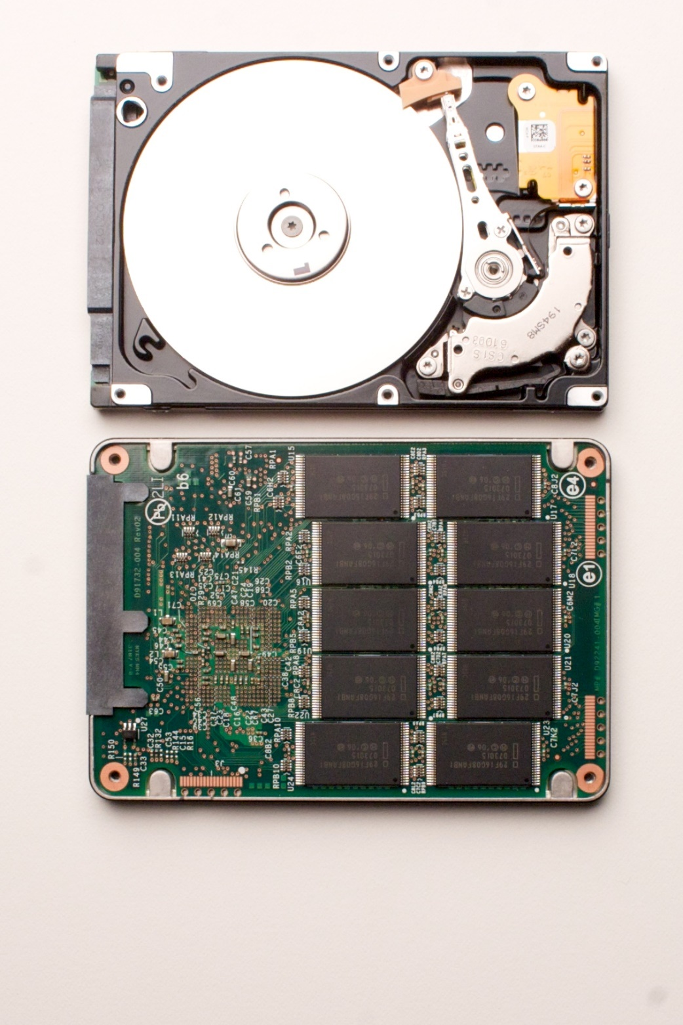
HDD vs. SSD
Notes:
Source: download.intel.com/pressroom/images/InsideHDDSSD.jpg

Slide 19
Networking
The world is now globally connected
Data can come from anywhere as long as the data and we are connected to the same network.
Networks are interconnected via the Internet

Slide 20
Physical connections
Types of connections
Copper
Fiber
Wireless
Protocols
How do we know when to start sending data?
How do we know who its from?
How do we know who its going to?
Types of physical connections
Ethernet
Wifi (802.11)
ATM

Slide 21
Packets
Unlike a telephone, true connections on a network are rare.
Data is sent from a program to another program indirectly by using multiple protocols.
Generally there will be protocols for:
Each application
Each logical network
Each physical network
In order to send data it is encapsulated into a packet and given to the application protocol, which then adds a header for information for the receiver to understand what’s being sent.
When the packet moves to the logical protocol, it too adds a header on top of the application layer’s header.
Data-link Network Application DATA

Slide 22
Layers we commonly use
Application
HTTP – Hyper Text Transport Protocol
SMTP – Simple Mail Transport Protocol
IMAP – Internet Mail Access Protocol
Logical (more formally called Network)
Usually broken down into two layers
Connection oriented vs. Connection less deals with the ordering and guarantee of delivery of packets
UDP
TCP
Global delivery of packets
Internet Protocol – IP
Physical
Often adds a header and footer (to indicate the end)
Mostly concerned with local addressing and how to deal with eccentricities of the physical medium
Ethernet
802.11

